Slide 1
The Cycle Manager
Glenn Larson

Slide 2
System Background
Key Functions:
Point of Sale System
Manage Products and New Bikes
Enter/Edit/Look-up Customer
Create/Update/Remove Service
Create and Manage Service Tickets.
Employee Clock-In/-Out
Sales & Service Report
Bonus Calculator

Slide 3
Feasibility
Costs
Benefits
Upfront
Labor
857.5 hours
$150/hr
Hardware
$2,500.00
Annual Support
$12,500.00
Increased Efficiency
Increased Sales
Less Paper Used
Return on Investment
398.06% over 5yrs
Payback Period
2 years & 289 days

Slide 4
Requirements Models
Actor –The Only Actor Is The Employee
Use Case Diagram
Employee
Managerial System
Sales and Service System
Enter Service Ticket
Use Case Description
Enter Service Ticket

Slide 5
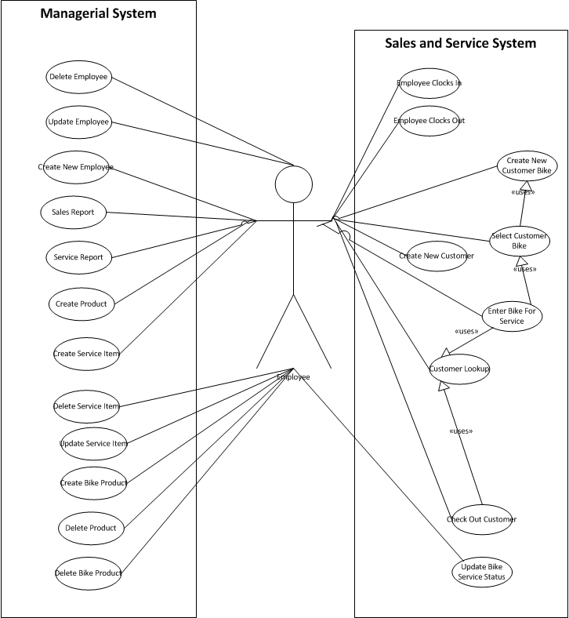
Actor

Slide 6
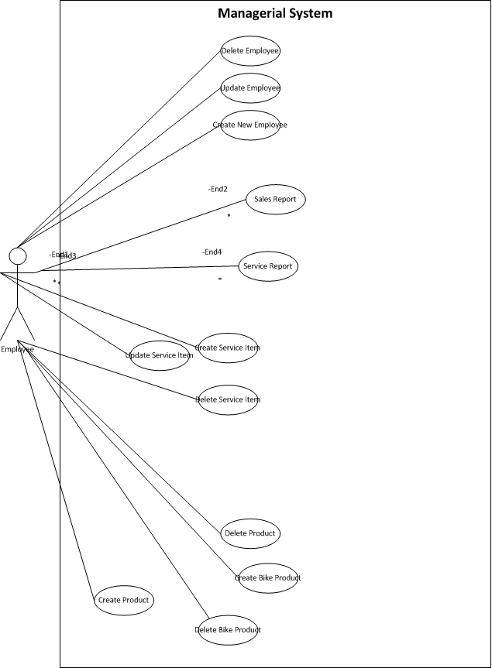
Managerial System

Slide 7
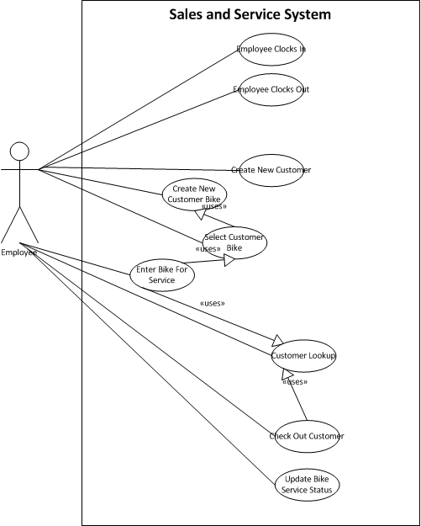
Sales and Service System

Slide 8
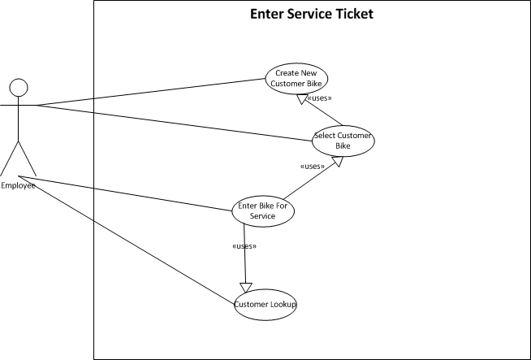
Enter Service Ticket

Slide 9
Enter Service Ticket
Use Case Name: | Enter Service ticket
Scenario: | Bike needs to be Entered For service
Triggering Event: | Customer brings Bike in For service
Brief Description: | When a customer brings bike in for service an employee needs to entere it into the system and choose the services the customer wants
Actors: | Employee
Stakeholders: | Employee Customer
Preconditions: | Customer Must Exist Employee Needs To be Clocked In
Postconditions: | Bike Service Needs To be Added to service Queue.
Flow of Activities: | Actor | System
 | 1.Customer Brings Bike In For Service 2.Employee Enters Customer Information(Uses Lookup Customer) 3.The Employee Then Selects the enter Bike For Service Button 4. The Employee Will Verify The Customer Information on screen 5.The Employee Will click the select bike button 6 If Customer Bike no listed the employee will click create new bike button(use create New Customer bike use case) 7. Employee will select bike from list(use Select Customer Bike Use Case) 8. The employee click add service button 9 the employee will select services that are wanted 10. the employee will enter description 11. The employee saves service ticket | 2.1 Customer Information Loaded 3.1 The System Loads the enter Bike for Service Form 5.1The select Bike Screen will show with a list of the customers bikes. 7.1.a the bike information will populate the bike service form 8.1 The add service screen will appear 9.1 The services will populate the selected services list
Exception Conditions: | 1.Customer Must be loaded or it will ask employee to lookup customer 2. Once Bike Service Screen Shows it will not allow it to be saved until a bike is selected and a service is selected.

Slide 10
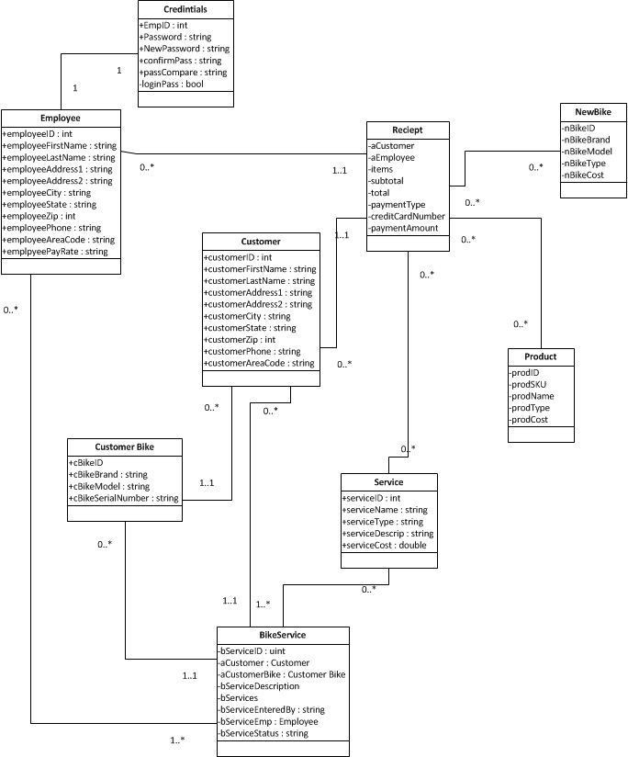
Domain model Class Diagram

Slide 11
Prototypes
Screen Designs
Report Designs
Menu Hierarchy
Relation to Event Table

Slide 12
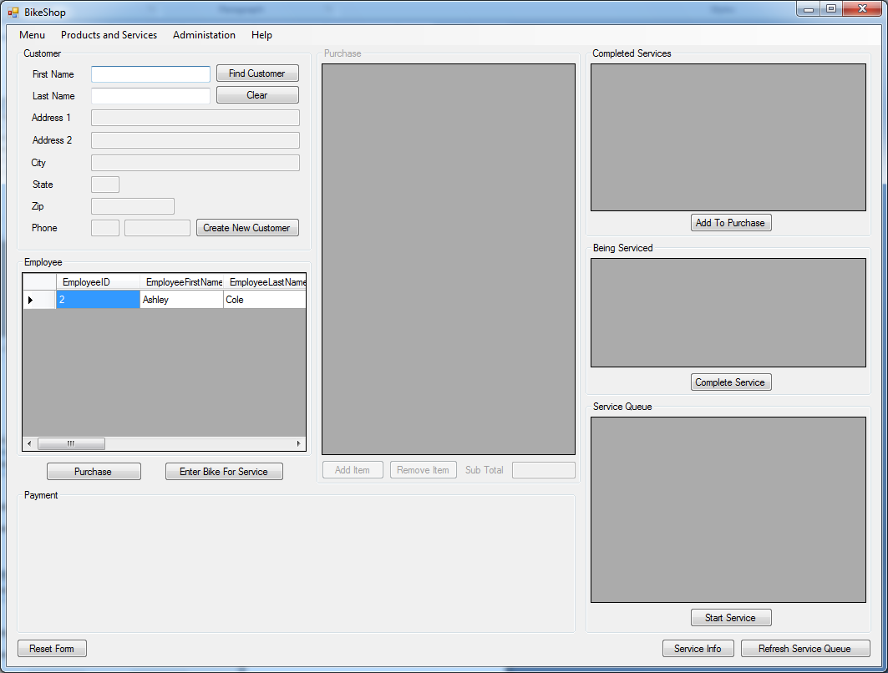
Employee Clocked In

Slide 13
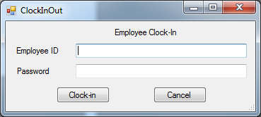
Employee Clock In

Slide 14
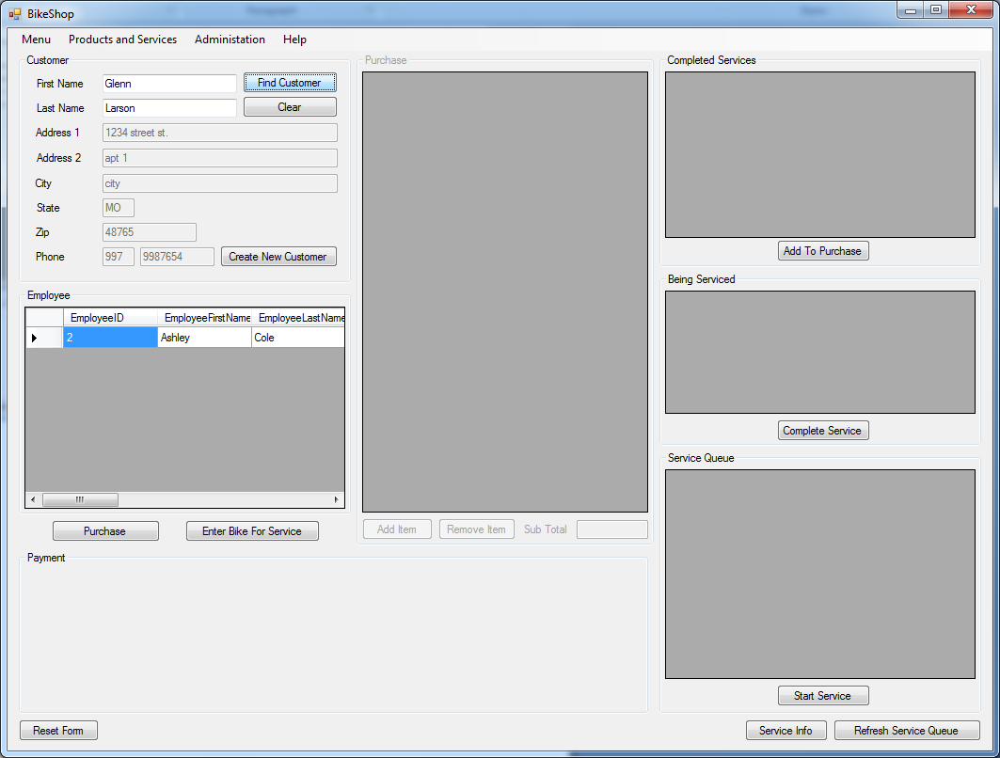
LookUp Customer

Slide 15
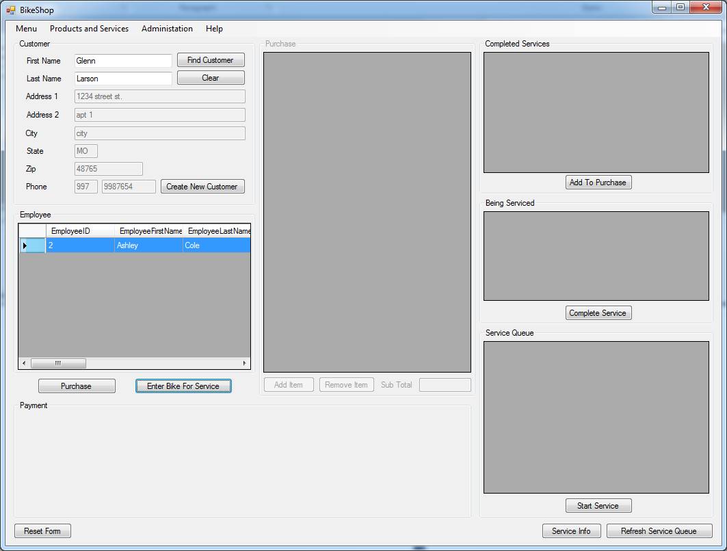
Enter Service Ticket Screens

Slide 16
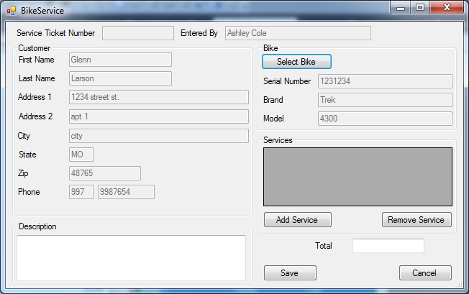
Enter Service Ticket Screens

Slide 17
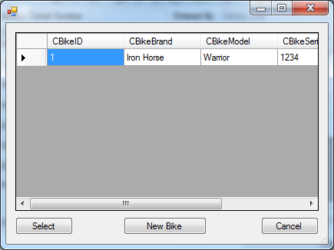
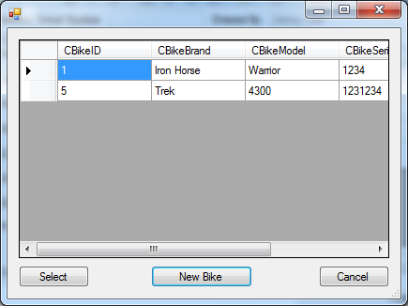
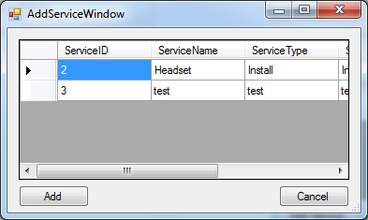
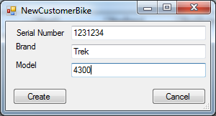
Enter Service Ticket Screens

Slide 18
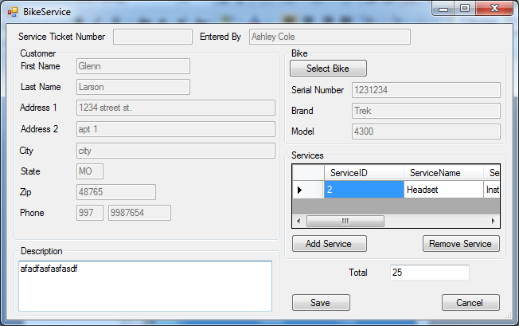
Enter Service Ticket Screens

Slide 19
Report #1
Employee Service Bonus Report
Date Range
10/1/2011 – 10/31/2011
Employee Name Number Of Services Most Common Service Bonus
Glenn Larson 5 Headset $20.00
Ashley Cole 10 Tune-Up $40.00
Bart Simpson 0 none $0.00
Charlie Sheen 25 Winning $100.00
Glenn Larson 5 Headset $20.00
Ashley Cole 10 Tune-Up $40.00
Bart Simpson 0 none $0.00
Charlie Sheen 25 Winning $100.00

Slide 20
Report #2
Date Range
10/1/2011 – 10/31/2011
Item Name Number Sold This Month Number Sold To Date
Handle Bar 5 10
Headset 2 5
Suspension Fork 1 1
Trek Bike 2 3
Specialized Bike 3 6
Services 30 100

Slide 21
Menu Hierarchy
Menu
Employee Clock In
Employee Clock Out
Exit
Products and Services
Manage Products
Manage Services
Manage New Bikes
Administration
Employees
Help
Help

Slide 22
Application Architecture
C#
Visual Studio 2010
Access
3 layer
Presentation
Business Layer
Data Access

Slide 23
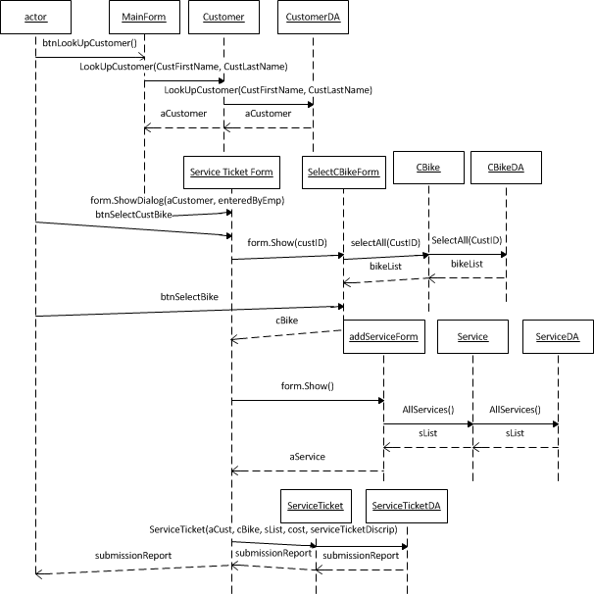
Enter Service Ticket SSD

